Slide 1
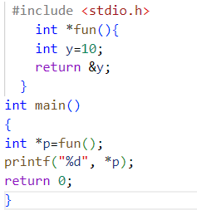
CE

Slide 2

FUNCTION
y
*p
ADDRESS
NT

Slide 3
prefix to indicate the number is in hexadecimal
32-bit integer
Little Endian
(4 byte)
0x0A
0x0B
0x0C
0x0D
0x0D
0x0C
0x0B
0x0A
0x0A0B0C0D
a
a+1
a+2
a+4
LOWER
HIGHER
Big Endian
Memory
0x0A
0x0B
0x0C
0x0D
a
a+1
a+2
a+4

Slide 4
1
ADDITION
SUBTRACTION
MULTIPLICATION
15
+7
2
2
2)20(
1
Division
0
-2
___
00

Slide 5
NO PERFORMANCE GAIN
AMD, X86 - L.ENDIAN
NETWORK PROTOCOLS
BIG ENDIAN
NT

Slide 6
Bitfield
CE
NT

Slide 7
x64
x86
Chunks
Read
Memory
CPU
Memory
1 | 2 | 3 | 4 | 5 | 6 | 7 | 8
Write

Slide 8
Short Int
(2 bytes)
Misaligned
 |  |  |  |  |  |  | 1
2
x64
Aligned Properly
1 | 2

Slide 9
Padding to align
x86
char *p; /*4 bytes*/
char c; /*1 byte*/
char pad[3]; /*3 bytes*/
int x; /*4 bytes*/
*p
c
padding
x
NT

Slide 10
Structure alignment and padding
struct Foo{
char *p; //8 bytes
long x; //4 bytes
char c; //1 byte
char pad[3]; //3 bytes - trailing padding
};
struct Bar{
char c;
char pad1[7];
struct baz{
char *p;
short x;
char pad2[6];
}baz;
};
NT

Slide 11

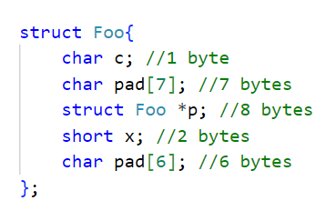
Structure reordering
CE
c
X
Padding 5
Padding 7
*p
X
Padding 6
16 bytes instead of 24 bytes
(Code example)

Slide 12
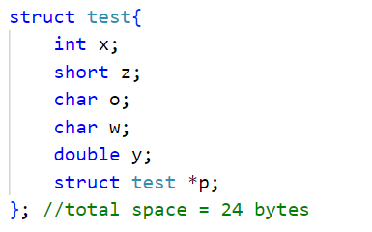
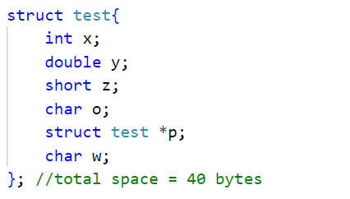
Try reordering this!
Almost half the size!
NT

Slide 13
Structure bitfields:
Precisely occupying memory space according to our needs
CE

Slide 14
Readability and Cache locality
Just because you can do something doesn’t mean you should.
What is a cache line?
the smallest portion of data that can be mapped into a cache

Slide 15
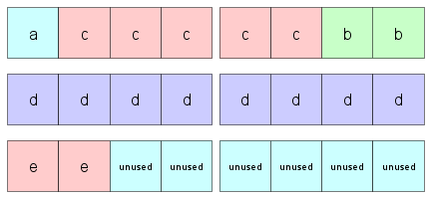
Breaking free from the alignment rules
#pragma pack (n);
//n=1,2,4,8,16
NT

Slide 16

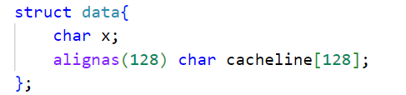
C operator align of and align as
CE
x64
8 byte alignment
16 byte alignment
128 byte alignment/ chunk
NT

Slide 17
PROGRAM MEMORY
TEXT SEGMENT
INITIALIZED DATA SEGMENT
UNINITIALIZED DATA SEGMENT (BSS)
HEAP
STACK

Slide 18
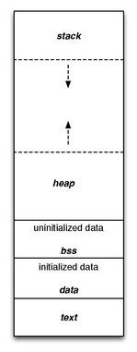

Slide 19
Code Segment
..object file or the corresponding section of
the program's address space that contains
executable instructions…
Placed below stack and heap to prevent overwrite

Slide 20
Data Segment
the corresponding address space of a program that contains initialized static variables,global and local variables
read/write
Size determined by the source code values
Doesn’t change during runtime

Slide 21
Block Starting Symbol (BSS Segment)
object file or executable that contains statically allocated variables that are declared but have not been assigned a value yet
no data

Slide 22
Stack
LIFO
"stack pointer" register tracks the top of the stack
Push and Pop
Stack overflow
Stack underflow
Stack grows towards heap and vice versa

Slide 23
Heap
ways to dynamically allocate portions of memory to programs at the programmer’s request
(unlike stack which is fixed in size)
Free it when no longer needed
Time penalty; slower than stack

Slide 24
Malloc, realloc and free
CE
Heap allocation
ptr = (cast-type*) malloc(byte-size)
ptr = realloc(ptr, newSize);
free(ptr);

